Slide 1


Tumor Mutational Burden (TMB) in the cohort of Indian cancer patients using Whole Exome Sequencing
*Confidential, not for distribution

Slide 2
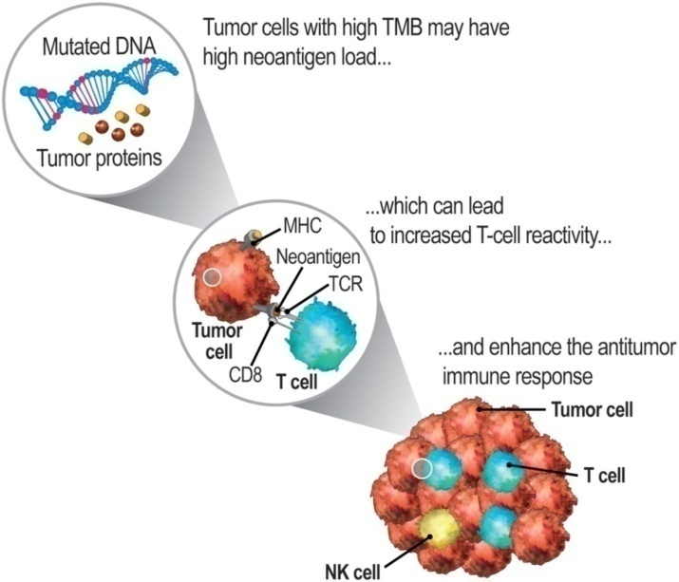
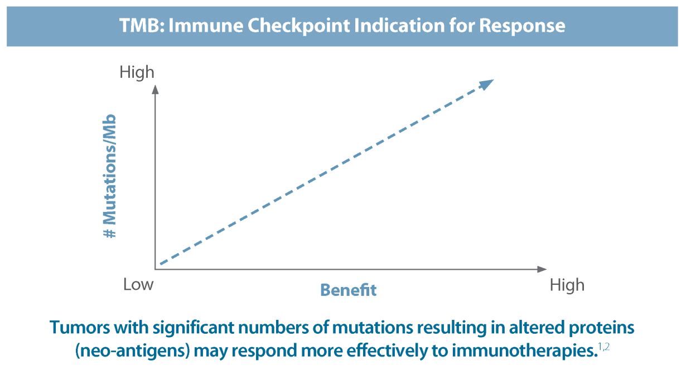
Tumor Mutation Burden (TMB)
Tumor mutational burden (TMB) is a measure of the mutation load in a tumor sample. High TMB is associated with production of more neo-antigens which may be recognized by the immune system and inciting an anti-tumor response. High TMB is associated with better response rate with immuno-checkpoint inhibitor.
There are no guidelines in calculation the Tumor mutation Burden.

Slide 3
Objective
To optimize the Quality Control parameters at each stage of Bioinformatics analysis.
To optimize the calculation of TMB using WES data
To study the trend of TMB in Indian cancer patient cohort and further classify based on the cancer type.
To check for the commonly mutated genes in High TMB patients.

Slide 4
Steps of the Project
Stages | Broad classification | Stage details
0 | Wet lab QC points | Library QC point Tumor content
1 | Bioinformatics analysis | Validate the bioinformatics pipeline and finalise the quality control parameters
2 | Categorization of Samples | Selecting the good samples by categorising them into good, intermediate and bad samples.
3 | Benchmarking | Different cell-lines will be used to detect known variants (already mentioned by vendor)
4 | Variant pattern | Variant artifact filtrating -True variant detection Popultaion based Germline Depth/quality Oncoplots (to check for variability in population and to know more about cohort)
5 | TMB calculation | Variation in cancer type In-silico validation of TMB

Slide 5
Stage1 Bioinformatics analysis
Objective :
Expected Outcome :
1A Cohort of the project
1B Bioinformatic analysis (Fastq → vcf)

Slide 6
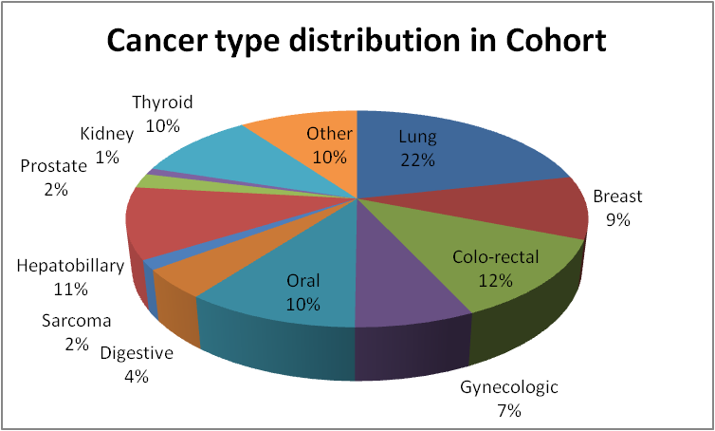
Stage 1A – Sample Cohort
Broad category | Total | Cancer type
Lung | 89 | Non small cell Cancer
Colo-rectal | 50 | colon, rectal, jejunum, Caecum Cancer
Hepatobillary | 44 | gall, pancreas, liver, periampullary, bile duct
Oral | 42 | oral, mouth, tongue, buccal, Maxilla, parotid, adenoid cystic, lip, head neck
Thyroid | 42
Other* | 41
Breast | 39
Gynecologic | 29 | Endometrium, ovarian, peritoneal, endocarcinoma
Digestive | 18 | esophagus, stomatch, perietal wall, Cricoid
Prostate | 9
Sarcoma | 6
Kidney | 4 | Bladder, pappilary
Total | 413
Revision of cohort - Nishtha
Notes:
Revision of cohort
Q1. All samples with bad quality and filter later on basis of QC matrix

Slide 7
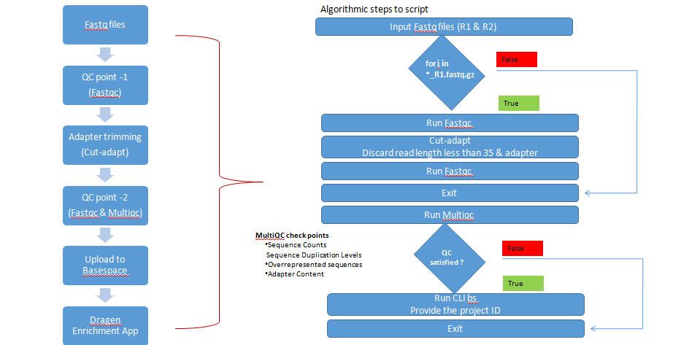
Stage1B - Bioinformatic analysis (Fastq -> vcf)
Notes:
Approved earlier for cut adapt and uploading.
GUI till cutadapt and bs upload: cutadapt_upload.py
Final GUI for sample processing (in-use): FinalGUI.py

Slide 8
Stage 2 Categorization of Samples
Objective :
To find important QC check point parameters and categorise the samples accordingly.
Expected Outcome :
We narrowed down to 10 parameter that need to be considered before the variant calling.
We came to conclusion of categorizing samples in bad, intermediate and good quality as per these mentioned parameters.

Slide 9
Stage 2 – Bioinformatics QC parameters
We started with 10 QC parameters.
We saw the range, median and density plot of all the parameter and decided to go further with marked 4 parameter.
Parameters considered | Range | Median
Percent duplicate aligned reads (0, 1,2) | 72.8 – 3.05 | 16.315
Percent aligned reads | 99.62 – 94.95 | 99.145
Unique base enrichment | 79.02 – 7.51 | 57.59
Percent Q30 bases | 97.46 – 91.54 | 95.06
Percent mismatches | 1.08 – 0.17 | 0.26
Mean target coverage depth | 545.4 – 6.5 | 103.45
Uniformity of coverage (Pct > 0.2*mean) | 99.7 – 74.17 | 94.59
Percent Target coverage at 50X | 99.9 – 0.67 | 77.73
Fragment length median | 215 – 69 | 144
Fragment length min | 58 - 23 | 35
REDO - Bhargavi
Notes:
Required or not ???
REDO

Slide 10
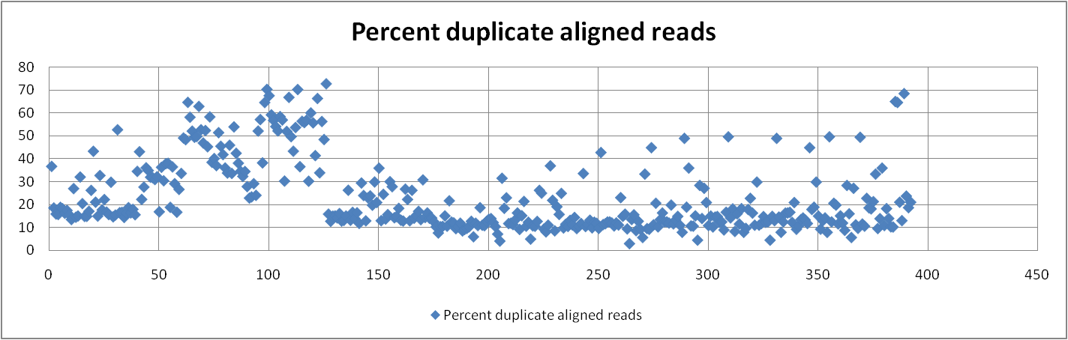
Stage1D-Bioinformatics QC points
REDO - Bhargavi
Notes:
Path of QC
Supplementary information

Slide 11
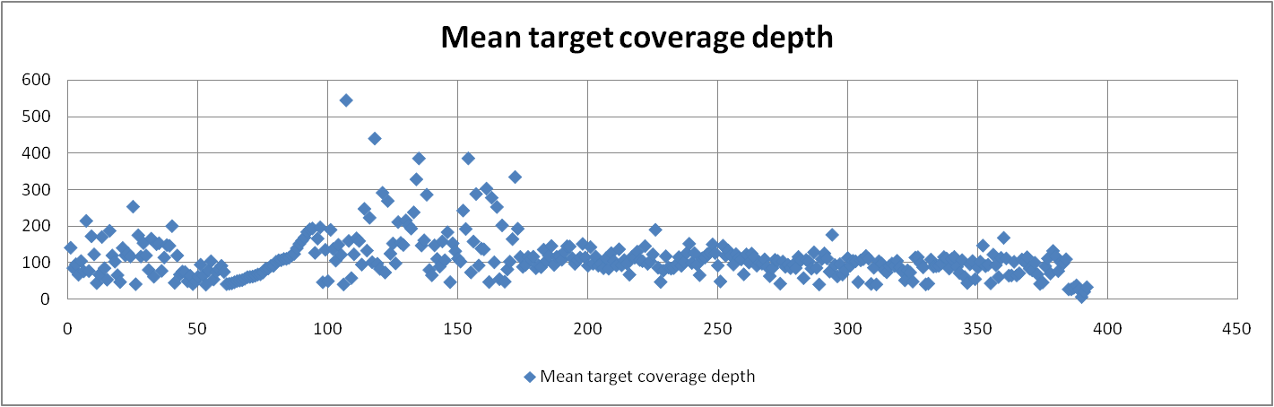
Stage1D-Bioinformatics QC points
REDO - Bhargavi
Notes:
Path of QC
Supplementary information

Slide 12
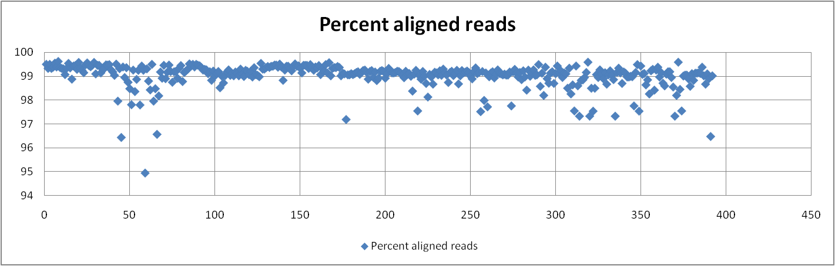
Stage1D-Bioinformatics QC points
REDO - Bhargavi
Notes:
Path of QC
Supplementary information

Slide 13
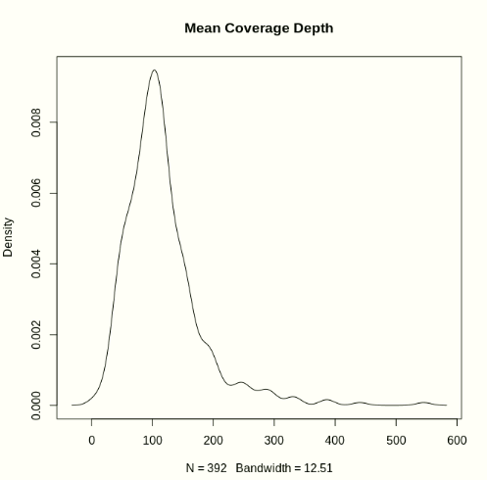
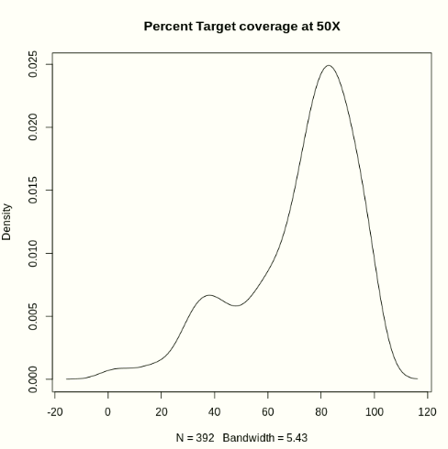
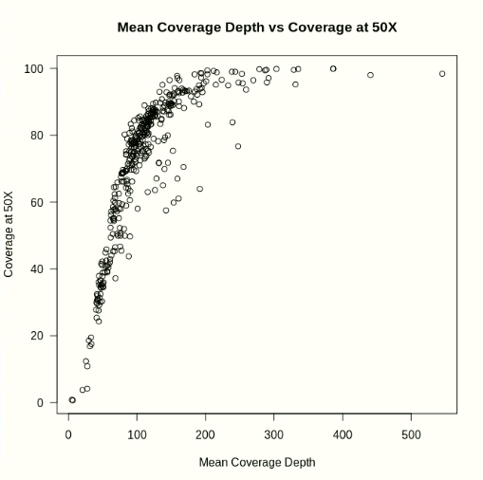
Stage1D-Bioinformatics QC points
Range:5.1 - 545.4 Median:105.35
Range:0.67 - 99.90 Median:77.995
REDO - Nishtha
Correlation coefficient : 0.7247256
Notes:
Script/Commands

Slide 14
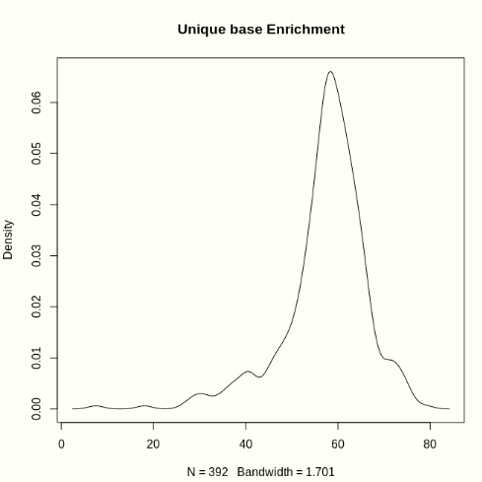
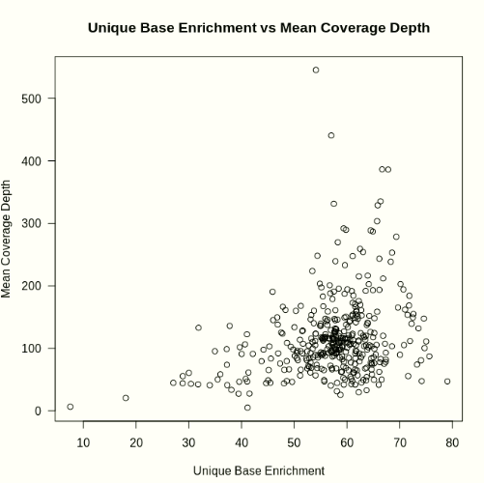
Stage1D-Bioinformatics QC points
Range:7.51 - 79.02 Median:58.425
Range:5.1 - 545.4 Median:105.35
REDO - Nishtha
Correlation coefficient : 0.2789064
Notes:
Script/Commands

Slide 15
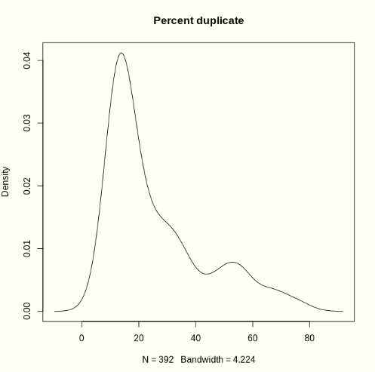
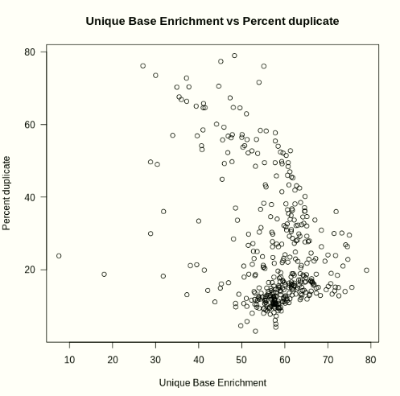
Stage1D-Bioinformatics QC points
Range:7.51 - 79.02 Median:58.425
Range:3.05 - 79.00 Median:18.46
REDO - Nishtha
Correlation coefficient : -0.3875462
Notes:
Script/Commands

Slide 16
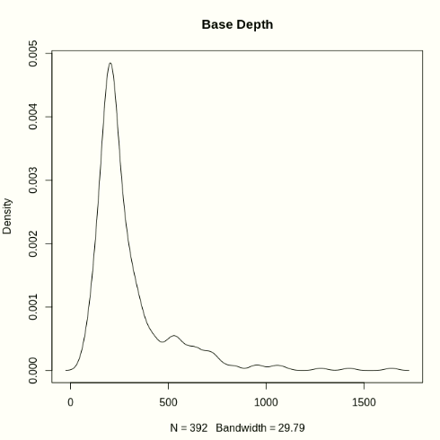
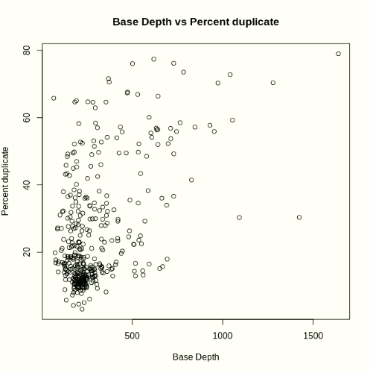
Stage1D-Bioinformatics QC points
Median:228.17 Range:64.69-1639.91
Range:3.05 - 79.00 Median:18.46
REDO - Nishtha
Correlation coefficient : 0.5073495
Notes:
Script/Commands

Slide 17
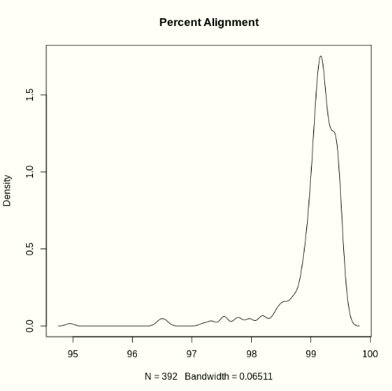
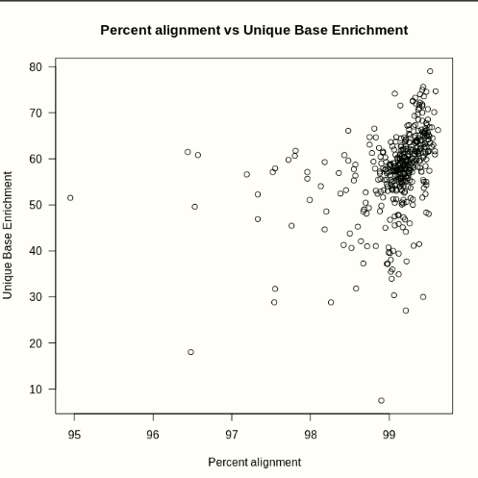
Stage1D-Bioinformatics QC points
Range:94.95 - 99.62 Median:99.17
Range:7.51 - 79.02 Median:58.425
REDO - Nishtha
Correlation coefficient : 0.3589332
Notes:
Script/Commands

Slide 18
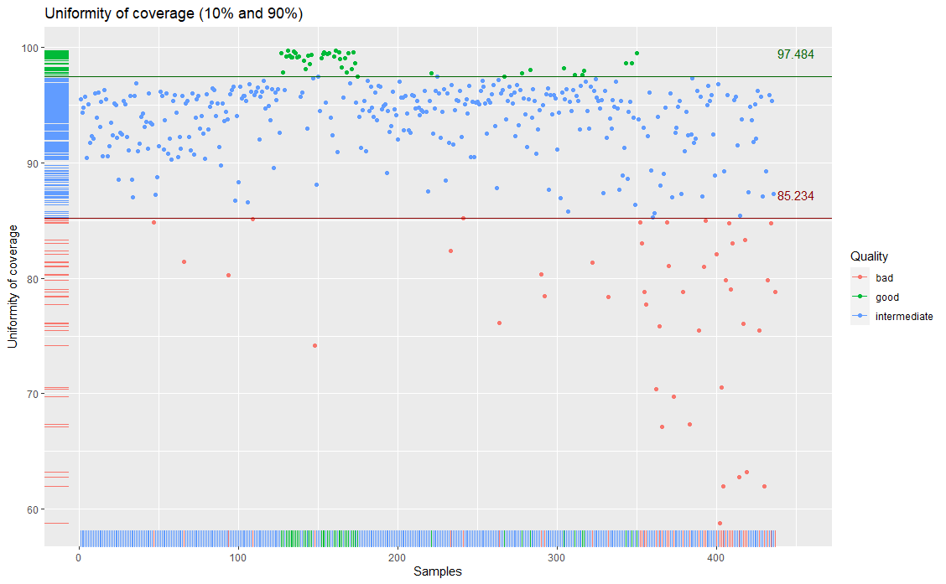
REDO - Aiswarya

Slide 19
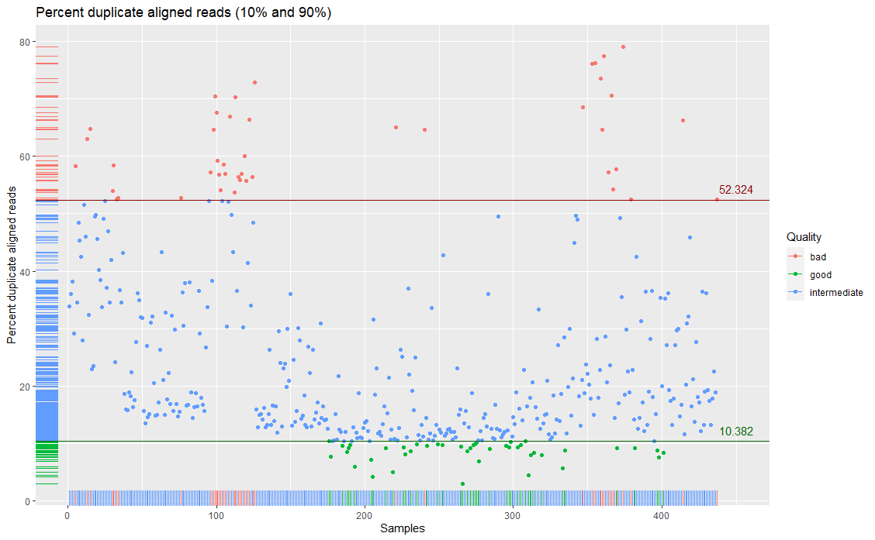
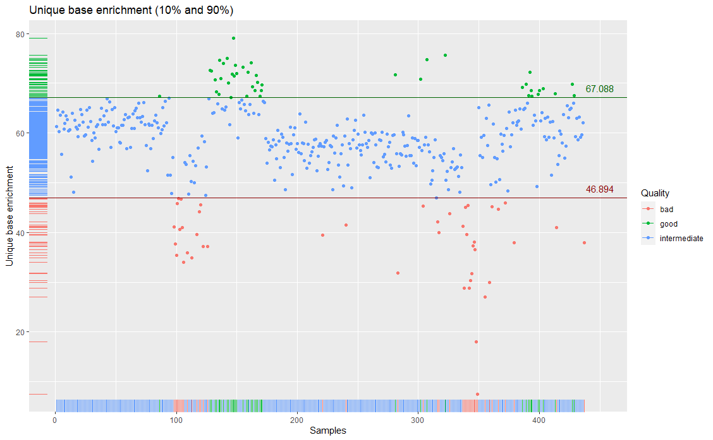
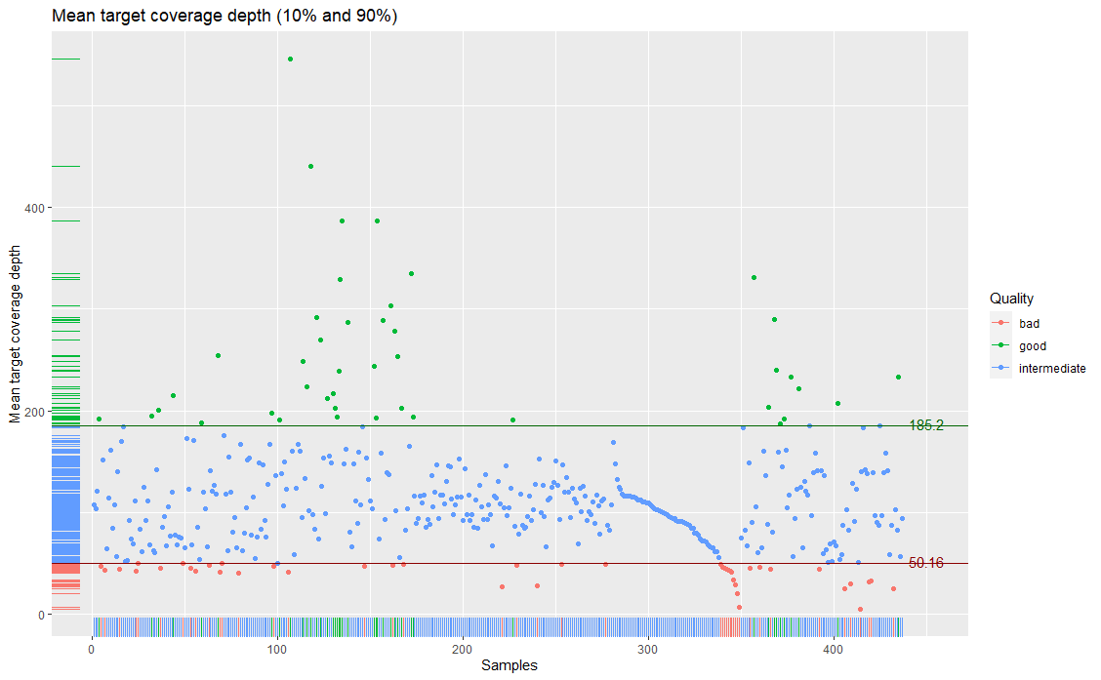
Stage 2 Categorizing of cohort based on QC parameters
REDO - Aiswarya
Notes:
Sample Sorting (QC Categorization): category_graph.R
Redo with complete cohort

Slide 20
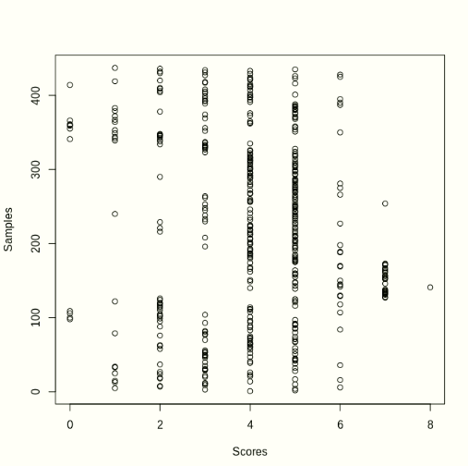
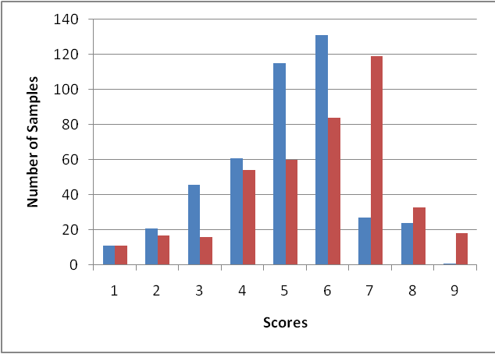
Stage 2 Categorizing of cohort based on QC parameters
Group A
Considered as bad samples
<20% Mean target depth
<20% Uniformity
<20% Unique Base enrichment
>80% Percent Duplicates
Group B
Considered as bad samples
<10% Mean target depth
<10% Uniformity
<10% Unique Base enrichment
>90% Percent Duplicates
Scoring of each sample ranging from 0- 8, where 0 represent that sample has failed in all the QC check points and score represent high quality sample.
The figure represent that majority of the samples lies in the intermediate category
REDO – Nishtha/ash
Notes:
Scoring commands
0, 1 score to remove
Score 2 has to recheck

Slide 21
Stage 4- Artefact filteration
vcf file from Dragen
vcf file (Table to text)
depth, allelic frequency, quality
Annotation by annovar
Annotation by Intervar
Annotation by Cancervar
https://academic.oup.com/nar/article/38/16/e164/1749458
https://linkinghub.elsevier.com/retrieve/pii/S0002929717300046
https://www.biorxiv.org/content/10.1101/2020.10.06.323162v1
Server - https://cancervar.wglab.org/
DONE

Slide 22
Stage 4- Annotation
Basic Information | Population | Insilico | Clinical Significance | InterVar | Cancer var | VCF & gatk
Chr | esp6500siv2_all | CADD | avsnp150 |  |  | QUAL
Start | 1000g2015aug_all | DANN | Interpro_domain | InterVar: InterVar and Evidence | Pathway | FILTER
End | ExAC_ALL | dbscSNV | CLNALLELEID | rmsk | Therap_list | INFO:DP
Ref | ExAC_AFR | Eigen | CLNDN | OMIM Phenotype_MIM | CancerVar score | INFO:FractionInformativeReads
Alt | ExAC_AMR | FATHMM | CLNDISDB | OrphaNumber Orpha | Diag_list | INFO:MQ
Func.refGene | ExAC_EAS | fathmm-MKL | CLNREVSTAT |  | Prog_list | MQRankSum
Gene.refGene | ExAC_FIN | GenoCanyon | CLNSIG |  |  | NLOD
GeneDetail.refGene | ExAC_NFE | GERP++ | cosmic |  |  | ReadPosRankSum
ExonicFunc.refGene | ExAC_OTH | GTEx | ICGC_Id |  |  | INFO:TLOD
AAChange.refGene | ExAC_SAS | integrated | ICGC_Occurrence |  |  | AD
Func.ensGene | gnomAD_genome_ALL | Interpro |  |  |  | AF
Gene.ensGene | gnomAD_genome_AFR | LRT |  |  |  | DP
GeneDetail.ensGene | gnomAD_genome_AMR | M-CAP |  |  |  | F1R2
ExonicFunc.ensGene | gnomAD_genome_ASJ | MetaLR |  |  |  | F2R1
AAChange.ensGene | gnomAD_genome_EAS | MetaSVM |  |  |  | FT
Func.knownGene | gnomAD_genome_FIN | MutationAssessor |  |  |  | GT
Gene.knownGene | gnomAD_genome_NFE | MutationTaster |  |  |  | MB
GeneDetail.knownGene | gnomAD_genome_OTH | MutPred |  |  |  | OBAM
ExonicFunc.knownGene |  | phastCons100way |  |  |  | OBAMRC
AAChange.knownGene |  | phyloP100way |  |  |  | OBF
 |  | Polyphen2 |  |  |  | OBP
 |  | PROVEAN |  |  |  | OBQ
 |  | REVEL |  |  |  | OBQRC
 |  | SIFT |  |  |  | PS
 |  | SiPhy |  |  |  | SB
 |  | VEST3 |  |  |  | SQ

Slide 23
Filtration Strategy
REDO – last file - nishtha
Step 1 | Step2 | Step3 | Step4 | Step6 | Step5 | Step7
VCF & gatk | Basic Information | Population | Insilico | Clinical Significance | InterVar | Cancer var
QUAL | Chr | esp6500siv2_all | CADD | avsnp150
FILTER | Start | 1000g2015aug_all | DANN | Interpro_domain | InterVar: Interwar and Evidence | Pathway
INFO:DP | End | ExAC_ALL | dbscSNV | CLNALLELEID | rmsk | Therap_list
INFO:FractionInformativeReads | Ref | ExAC_AFR | Eigen | CLNDN | OMIM Phenotype_MIM | CancerVar score
INFO:MQ | Alt | ExAC_AMR | FATHMM | CLNDISDB | OrphaNumber Orpha | Diag_list
MQRankSum | Func.refGene | ExAC_EAS | fathmm-MKL | CLNREVSTAT |  | Prog_list
NLOD | Gene.refGene | ExAC_FIN | GenoCanyon | CLNSIG
ReadPosRankSum | GeneDetail.refGene | ExAC_NFE | GERP++ | cosmic
INFO:TLOD | ExonicFunc.refGene | ExAC_OTH | GTEx | ICGC_Id
AD | AAChange.refGene | ExAC_SAS | integrated | ICGC_Occurrence
AF | Func.ensGene | gnomAD_genome_ALL | Interpro
DP | Gene.ensGene | gnomAD_genome_AFR | LRT
F1R2 | GeneDetail.ensGene | gnomAD_genome_AMR | M-CAP
F2R1 | ExonicFunc.ensGene | gnomAD_genome_ASJ | MetaLR
FT | AAChange.ensGene | gnomAD_genome_EAS | MetaSVM
GT | Func.knownGene | gnomAD_genome_FIN | MutationAssessor
MB | Gene.knownGene | gnomAD_genome_NFE | MutationTaster
OBAM | GeneDetail.knownGene | gnomAD_genome_OTH | MutPred
OBAMRC | ExonicFunc.knownGene |  | phastCons100way
OBF | AAChange.knownGene |  | phyloP100way
OBP |  |  | Polyphen2
OBQ |  |  | PROVEAN
OBQRC |  |  | REVEL
PS |  |  | SIFT
SB |  |  | SiPhy
SQ |  |  | VEST3

Slide 24
Allelic burden > 5%
Mapping quality >20
DP > 5
Level 2 Germline filteration
Level 3 Germline filteration
Total variants
Proceed with Exonic/splicing variants
Population frequency (maf < 0.01)
Remove synonymous variants
Mutation / panel size
In-silico prediction filteration
Remove benign variant in Clinvar
Predicated benign in Intervar
Predicated benign in CancerVar
Predicated benign in Intervar/CancerVAR
Level 2 and Level 3 Germline filteration
In-silico prediction filteration
Remove benign variant in Clinvar
Level 1 germline filteration
Steps common in all the pipeline
Validation to be done from Satya/Aiswarya
4 samples
2 nishtha
2 richa
Steps for somatic enriched variants
Steps for therapeutic (somatic + germline)
Steps for TMB calculation
Frequency in South Asian population:
GnomAD Genome ≤ 0.01 Frequency
ExAC Exome ≤ 0.01 Frequency
1000 Genome ≤ 0.01 Frequency
Level 1: Tolerant approach
Population frequency
Level 2: Stringent approach
Variant read frequency or allele burden
Level 3: Baseline approach
In-house baseline from germline samples
True negatives
Notes:
TMB merge: TMB_merge.py
TMB merge and filter: TMB_woart_cdfd.py

Slide 25
Stage 4- Filteration and Artifacts
Variant calling (SNVs and InDels)
Variant type
Variant location
Non synonymous
Removal of Germline Variant
Frequency in South Asian population:
GnomAD Genome ≤ 0.01 Frequency
ExAC Exome ≤ 0.01 Frequency
1000 Genome ≤ 0.01 Frequency
Level 1: Tolerant approach
Population frequency
Level 2: Stringent approach
Variant read frequency or allele burden
Variant Read Frequency >=0.55 or <=0.45
Level 3: Baseline approach
In-house baseline from germline samples
In-house baseline filtering
Patient’s TMB
(Somatic variants per Megabase of sequenced data)
Notes:
redraw

Slide 26
Objective2
Objective2: To study the trend of TMB in the cohort of 200 cancer patients from Indian population
Level 1: Tolerant approach
Population frequency
Total variants detected from sequencing data from FFPE block
Only coding variants
(SNV+ InDels)
Synonymous removed
Level 2: Stringent approach
Variant read frequency
Tumor Mutation Burden
Level 3: Baseline approach
In-house baseline from germline samples
Suggestions:
To change population frequency to South Asian frequency instead of ALL frequency
To use Level 3 filtering and calculate TMB
To check if the data is skewed because of colorectal cancers
To calculate using resampling technique

Slide 27
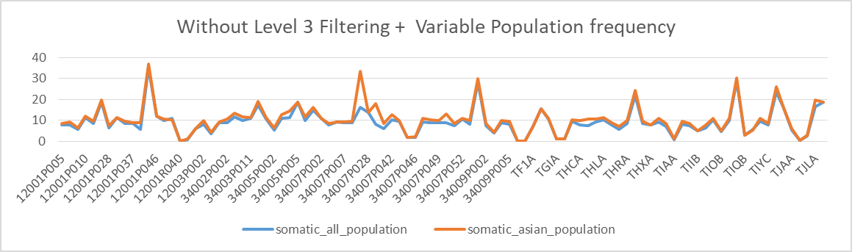
TMB Distribution with SAF /with ALL frequency
REDO – Aiswarya - With/without level 3
Different population (European vs asian)
Matched normal/Without matched
Notes:
Check quality
Redo
With/without level 3
Different population (European vs asian)
Matched normal/Without matched

Slide 28
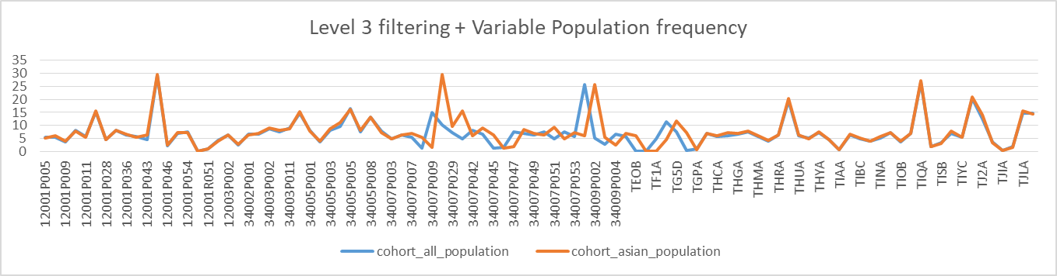
TMB Distribution with SAF /with ALL frequency
Changes: With Level 3 filtering (Baseline of 30 germline samples)
With/without level 3
Different population (European vs asian)
Matched normal/Without matched
Notes:
Check quality
Redo
With/without level 3
Different population (European vs asian)
Matched normal/Without matched

Slide 29
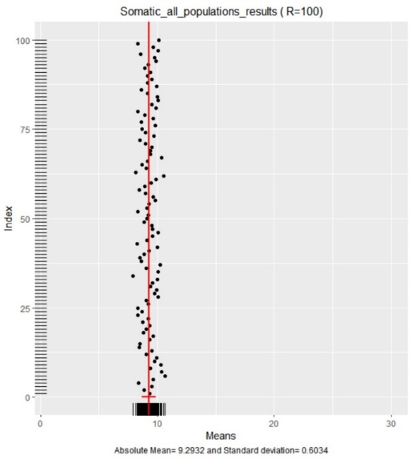
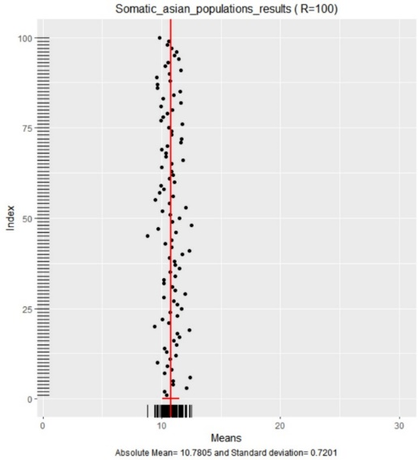
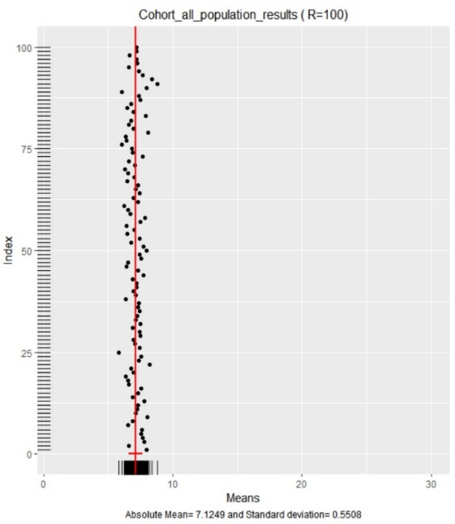
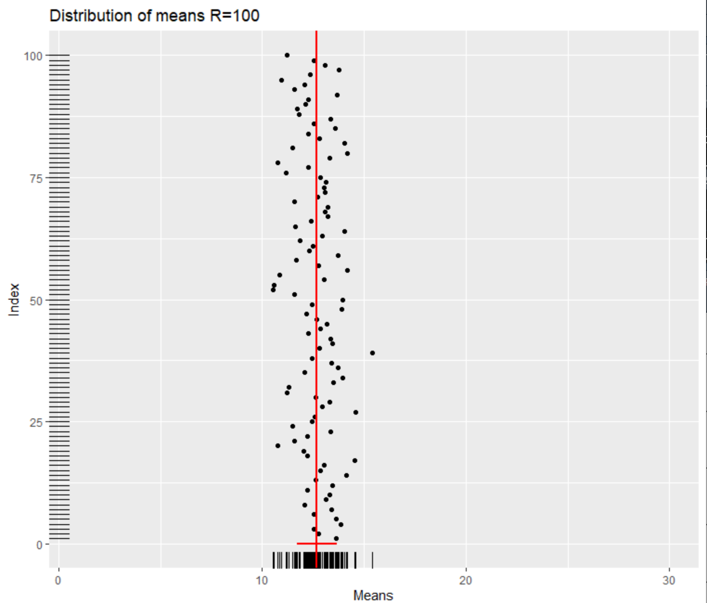
South Asian population frequency and Level 3 filtering
South Asian population frequency and Level 3 filtering

Slide 30
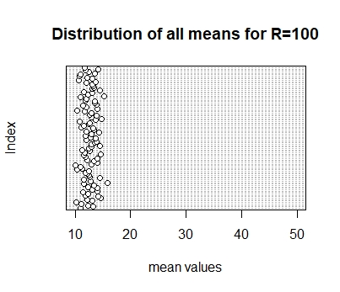
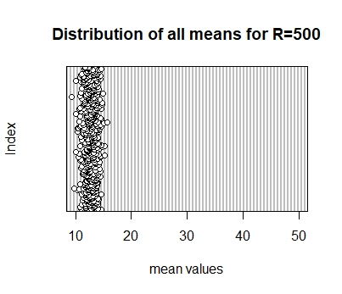
South Asian population frequency and Level 3 filtering

Slide 31
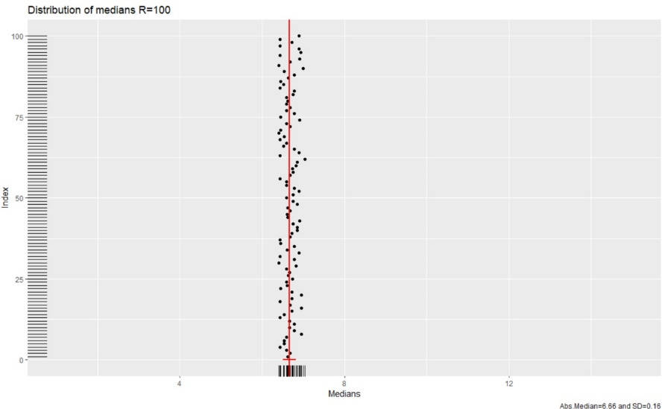
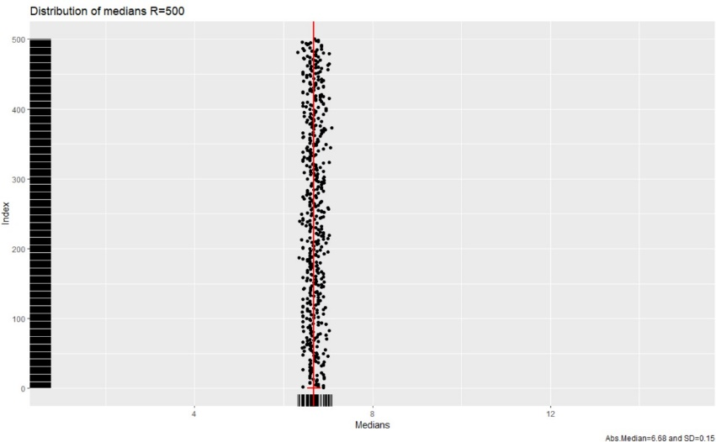
Data Resampling
Calculation for TMB cut-off
Suggestion: TMB cut off the data should be calculated using high-20 values in the cohort.
Data - cohort_Asian
Script -stim_dist.R

Slide 32
Data resampling - Calculation for TMB cut-off
DECILE
 | With outlier | Without outlier |  |  | With outlier | Without outlier
0% | 0 | 0 |  | 0% | 0 | 0
10% | 1.088889 | 1.057778 |  | 20% | 3.904399 | 3.897687
20% | 3.894331 | 3.887619 |  | 40% | 6.093878 | 6.085714
30% | 5.188889 | 5.168889 |  | 60% | 7.293878 | 7.284385
40% | 6.091837 | 6.083673 |  | 80% | 9.669206 | 9.591746
50% | 6.682086 | 6.653061 |  | 100% | 63.79592 | 31.73333
60% | 7.295918 | 7.28505
70% | 8.183673 | 8.130612
80% | 9.739683 | 9.606984
90% | 15.62834 | 15.59592
100% | 63.79592 | 31.73333
Data - cohort_Asian
Script - tmb_graphs.R

Slide 33
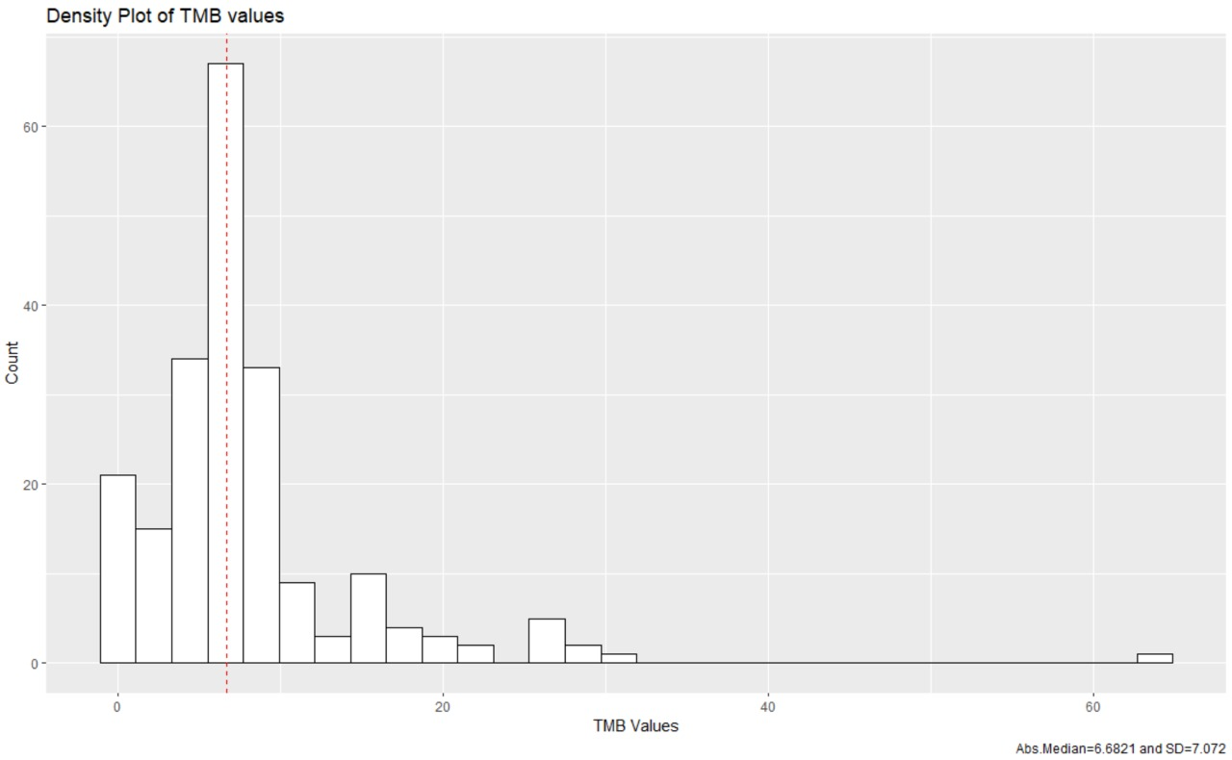
TMB Distribution in Indian cohort
Outlier
Data- cohort_Asian
Script - tmb_graphs.R

Slide 34
Samples with High TMB/High MSI
S.No. | Patient ID | Cancer type | MSI | TMB |  | S.No. | Patient ID | Cancer type | MSI | TMB
1 | 12001P016 | Digestive | 27.12 | 27.81633 |  | 25 | TJ2A | Colorectal | 16.92 | 14.08889
2 | 12001P019 | Oral | 9.83 | 11.53061 |  | 26 | TJ2C | Colorectal | 23.38 | 3.911111
3 | 12001P022 | Liver | 9.81 | 10.79592 |  | 27 | TJGA | Gynecologic | 14.76 | 14.82222
4 | 12001P027 | Lung | 9.45284 | 15.57143 |  | 28 | TJHA | Other | 16.17 | 16.68889
5 | 12001P044 | Colorectal | 15.17 | 26.61224 |  | 29 | TJLA | Colorectal | 16.26 | 15.64444
6 | 12001R040 | Colorectal | 24.63 | 0.142857 |  | 30 | TJNA | Colorectal | 16.01 | 10.11111
7 | 12001R051 | Colorectal | 68.04 | 0.897959 |  | 31 | TJVA | Liver | 15.79 | 31.73333
8 | 34003P012 | Lung | 5.98 | 15.32653 |  | 32 | TJZA | Colorectal | 22.41 | 5.355556
9 | 34005P004 | Liver | 5.06 | 11.06122 |  | 33 | TJZB | Breast | 12.83 | 14.35556
10 | 34005P005 | Digestive | 13.94 | 16.20408 |  | 34 | TKKB | Liver | 9.19 | 12.09302
11 | 34005P008 | Liver | 13.18 | 13.2449 |  | 35 | TKLB | Colorectal | 14.65 | 25.7907
12 | 34007P009 | Liver | 5.02 | 29.69388 |  | 36 | TKSA | Gynecologic | 17.74 | 14.71111
13 | 34007P019 | Lung | 13.87 | 18.02041 |  | 37 | TKTA | Lung | F1:- 19.83, F2:- 17.09 | 10.44186
14 | 34007P029 | Kidney | 3.1 | 15.61224 |  | 38 | TKTB | Digestive | 15.2 | 18.23256
15 | 34007P064 | Colorectal | 24.5 | 22.2449 |  | 39 | TKUA | Breast | 17.83 | 16.30233
16 | 34007P076 | Colorectal | 28.15 | 25.81633 |  | 40 | TKZB | Lung | 15.36 | 15.15556
17 | 34008P001 | Breast | 5.84 | 10.08163 |  | 41 | TLAA | Oral | 17.86 | 19.53333
18 | TEOB | Digestive | 20.1 | 0.122449 |  | 42 | TLBA | Gynecologic | 19.55 | 26.04444
19 | TFZA | Colorectal | 14.71 | 11.67347 |  | 43 | TLCA | Lung | 26.17 | 21.37778
20 | TG5B | Colorectal | 23.24 | 63.79592 |  | 44 | TLEA | Lung | 14.76 | 12.73333
21 | THRB | Prostate | 10.64 | 20.36735 |  | 45 | TLEB | Gynecologic | 14.87 | 17.17778
22 | TIHA | Liver | 8.79 | 10.16327 |  | 46 | TLIA | Liver | 20.31 | 8.422222
23 | TIQA | Liver | 10.48 | 27.28571 |  | 47 | TLRC | Liver | 23.66 | 9.622222
24 | TJ1C | Digestive | 17.72 | 20.86667
 |  |  |  |  |  | 48 | TEOC | Breast | 17.38 | 10.17

Slide 35
Data from Publication
Suggestion: TCGA or any other public data needs to be taken and different TMB cut-off values need to be calculated. This part can be used as limitation of the study.
 | Cancer | Patients | Medians
1 | Cutaneous Melanoma | 298 | 12.3
2 | NSCLC | 2084 | 5.3
3 | Breast | 1552 | 2.6
4 | Sarcoma | 741 | 1.8
5 | Colorectal | 1353 | 6.1
6 | Ovarian | 325 | 2.6
7 | Pancreatic | 849 | 3.5
8 | Endometrial | 427 | 6.1
9 | CNS | 511 | 3.5
10 | Prostatic | 569 | 2
11 | Gastric | 249 | 3.5
12 | Head & Neck | 174 | 4.4
13 | Hepatobiliary | 408 | 3
14 | Renal | 201 | 2.6
15 | Bladder | 232 | 8.8
16 | Esophageal | 138 | 5.3
17 | SCLC | 122 | 8.9

Slide 36
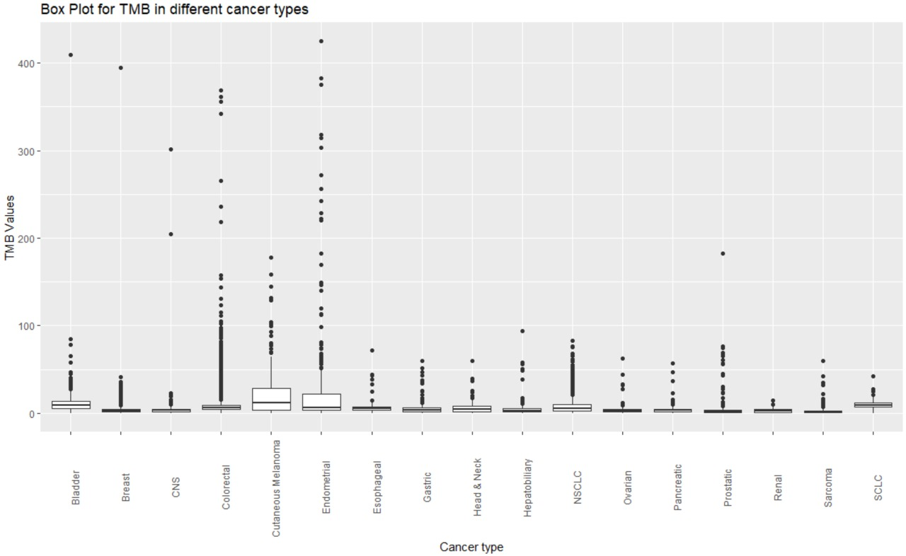
Data from Publication
Data - cancers
Script - diff_cancers.R

Slide 37
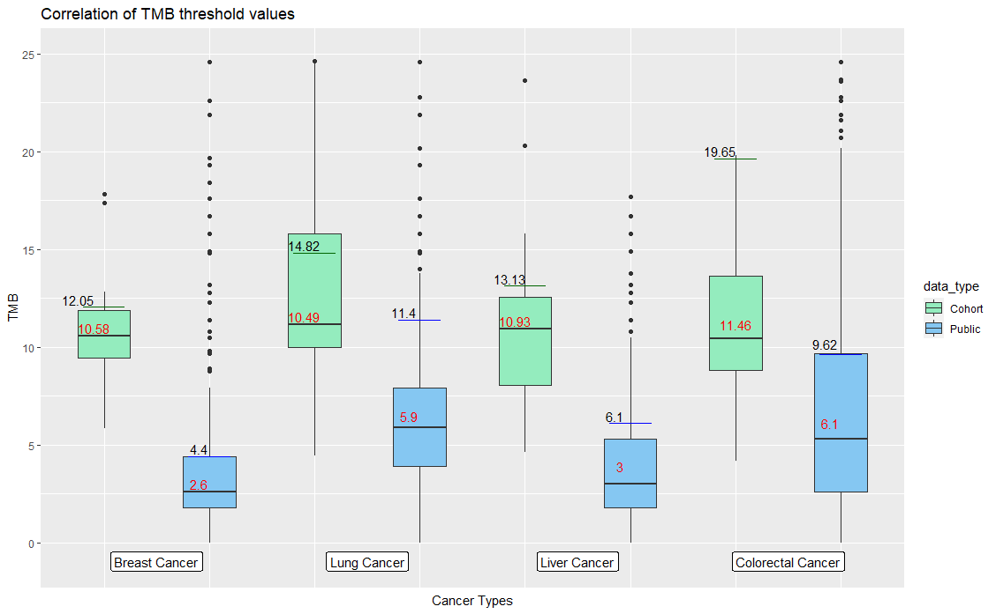

Slide 38
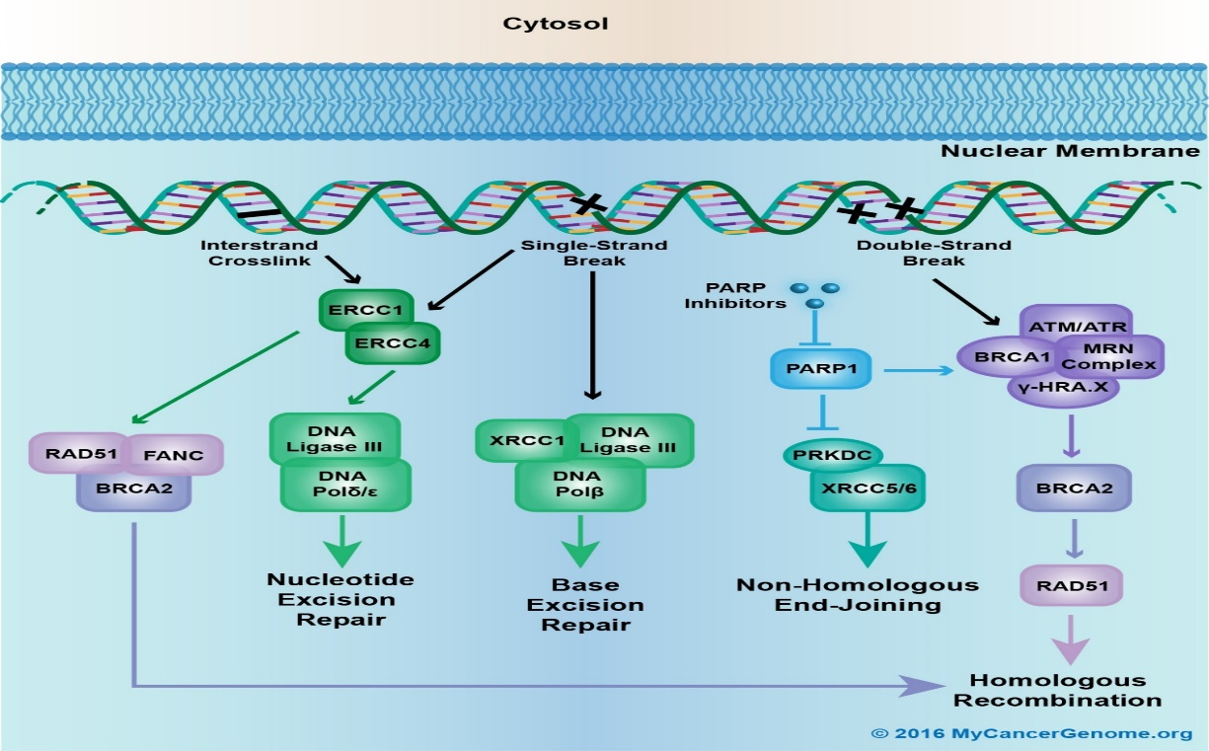
Mutation analysis
Suggestion: Frequently altered genes from DNA repair pathway in High TMB/High MSI patients.
24 genes involved in DNA damage/repair pathway
ATM | ATR | ATRX | BRCA1 | BRCA2 | BRIP1 | C11orf30 | FANCA | FANCC | FANCD2 | FANCE | FANCF
FANCG | FANCL | MDM2 | MDM4 | MLH1 | MUTYH | NPM1 | PALB2 | PPP2R1A | RAD50 | RAD51 | STAG2

Slide 39
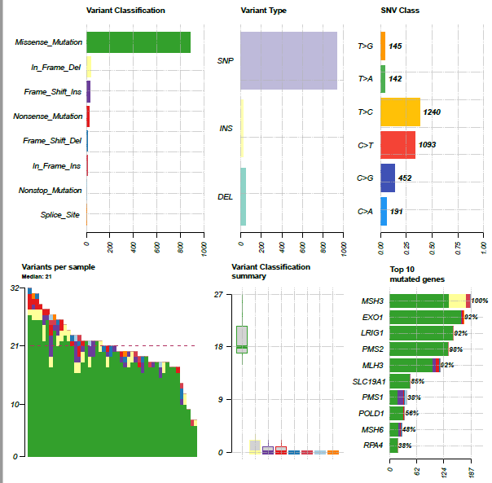
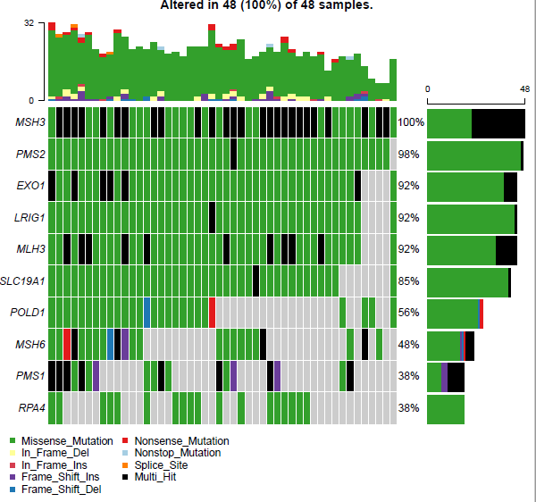
Top 10 mutated genes
Suggestion: Frequently altered genes from DNA repair pathway in High TMB/High MSI patients.

Slide 40
Pathogenic variants in DNA repair pathway
Suggestion: Frequently altered genes from DNA repair pathway in High TMB/High MSI patients.
S.NO | ID | Number of variants detected in DNA repair pathway | Pathogenic variant detected in DNA repair pathway |  | S.NO | ID | Number of variants detected in DNA repair pathway | Pathogenic variant detected in DNA repair pathway
1 | 12001P027 |  |  |  | 25 | TJ1C
2 | 12001P044 |  |  |  | 26 | TJ2A
3 | 12001R040 |  |  |  | 27 | TJ2C | 4 | MSH6, MLH1
4 | 12001R051 | 4 | MSH2, MSH3, MSH6 |  | 28 | TJGA | 1
5 | 34005P004 |  |  |  | 29 | TJHA
6 | 34005P005 | 1 | MLH1 |  | 30 | TJLA | 2
7 | 34005P008 | 2 | MSH6 |  | 31 | TJNA
8 | 34007P019 |  |  |  | 32 | TJVA | 3 | MSH6
9 | 34007P029 |  |  |  | 33 | TJZA | 1
10 | 34008P001 |  |  |  | 34 | TJZB
11 | SAMPLE-169 |  |  |  | 35 | TKKB
12 | SAMPLE-188 | 1 | PMS2 |  | 36 | TKLB | 3
13 | SAMPLE-26 | 1 |  |  | 37 | TKSA | 1
14 | SAMPLE-35 |  |  |  | 38 | TKTA | 1
15 | SAMPLE-39 |  |  |  | 39 | TKTB
16 | SAMPLE-69 | 1 |  |  | 40 | TKUA
17 | SAMPLE-80 | 3 |  |  | 41 | TKZB
18 | TEOB |  |  |  | 42 | TLAA | 1
19 | TEOC |  |  |  | 43 | TLBA | 2
20 | TFZA |  |  |  | 44 | TLCA | 1
21 | TG5B | 5 | MSH2, MSH6 |  | 45 | TLEA
22 | THRB |  |  |  | 46 | TLEB
23 | TIHA | 1 |  |  | 47 | TLIA | 1 | MSH6
24 | TIQA |  |  |  | 48 | TLRC

Slide 41
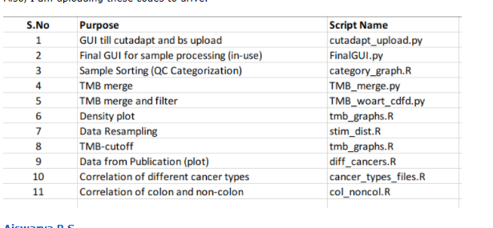

Slide 42
Stages of the Project
Stages | Broad classification | Stage details
0 | Wet lab QC points | Library QC point Tumor content
1 | Bioinformatics analysis | Validate the bioinformatics pipeline and finalise the quality control parameters
2 | Categorization of Samples | Selecting the good samples by categorising them into good, intermediate and bad samples.
3 | Benchmarking | Different cell-lines will be used to detect known variants (already mentioned by vendor)
4 | Variant pattern | Variant artifact filtrating -True variant detection Popultaion based Germline Depth/quality Oncoplots (to check for variability in population and to know more about cohort)
5 | TMB calculation | Variation in cancer type In-silico validation of TMB

Slide 43
Notes:
Din, rin value
Criteria
roboutness

